Slide 1
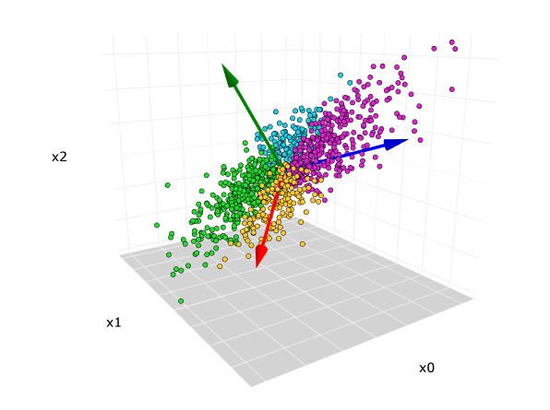
Principal Component Analysis
An Overview of Feature Extraction Techniques

Slide 2
Introduction
Feature Extraction?
Picking out the most important and useful parts from that messy data (kind of like summarizing it or highlighting the key points.).
Help a machine learning model understand what's going on.
Why Is It Important?
Reduces Complexity
Improves Model Performance
Speeds Up Computation
Helps in Interpretation
Techniques
Tabular Data: PCA, Normalization, Statistical Features.
Image Data: Edge Detection, Color Histograms, CNN Features.
Audio Data: MFCC (Mel Frequency Cepstral Coefficients), Chroma Features.
Text Data: TF-IDF, N-grams, Bag of Words

Slide 3
01
Algorithm Purpose

Slide 4
Problem Definition
Principal Component Analysis (PCA) is a statistical technique used to simplify complex datasets while preserving as much variability as possible.
Its main purpose is to reduce the dimensionality of data, making it easier to visualize and analyze. By transforming the original variables into a new set of uncorrelated variables (principal components), PCA helps address issues of multicollinearity and noise in data.

Slide 5
02
Algorithm

Slide 6
Step-by-step Explanation of PCA
Center the Data
How: Subtract the average value of each variable from every data point.
Example: If the average age is 20, subtract 20 from all students’ ages. Do the same for height and weight.
Result: Data is now centered around the origin, removing biases.
Calculate the Covariance Matrix
Goal: Understand how variables relate to each other.
How: Compute how much each pair of variables (age, height, weight) change together.
Example: If taller students tend to weigh more, height and weight have a positive covariance.
Result: A 3x3 matrix showing relationships between all variable pairs.

Slide 7
Step-by-step Explanation of PCA
Find Eigenvectors and Eigenvalues
Goal: Identify the "directions" of maximum variance (eigenvectors) and their "importance" (eigenvalues).
Eigenvectors: New axes (directions) where the data varies the most.
Example: One eigenvector might represent a mix of height and weight.
Eigenvalues: Measure how much variance each eigenvector captures.
Higher eigenvalue = more important direction.
4. Choose Principal Components
Goal: Pick the most important directions to reduce dimensions.
How: Sort eigenvectors by their eigenvalues (highest first). Select the top 1 or 2.
Example: Keep the top 2 eigenvectors (called PC1 and PC2) that explain 90% of the data’s variance.

Slide 8
Step-by-step Explanation of PCA
5. Transform the Data
Goal: Project data onto the new axes (principal components).
How: Multiply the centered data by the selected eigenvectors.
Example: Each student’s data (age, height, weight) is converted into two new values (PC1 and PC2).
Result: A simpler 2D dataset that retains most of the original patterns.

Slide 9
Inputs and Outputs
The inputs to PCA are a dataset consisting of multiple variables, often organized in a matrix format.
Each row represents an observation, and each column represents a feature.
The output of PCA is a set of principal components that represent the original data in a lower-dimensional space.
These components capture the most significant variance within the data, allowing for effective data representation with reduced dimensions. Typically, the first few principal components are sufficient to retain a substantial amount of the original data's information.

Slide 10
Illustrative Example
Student | Age | Height | Weight
1 | 20 | 170 | 65
2 | 22 | 180 | 80
3 | 19 | 165 | 55
4 | 21 | 175 | 70
Let’s break down PCA using 4 students with 3 variables: Age (years), Height (cm), Weight (kg)
Step 1: Center the Data
Subtract the mean of each column to shift data to the origin.
Means: Age = 20.5, Height = 172.5, Weight = 67.5
Centered Data:
Student | Age | Height | Weight
1 | -0.5 | -2.5 | -2.5
2 | 1.5 | 7.5 | 12.5
3 | -1.5 | -7.5 | -12.5
4 | 0.5 | 2.5 | 2.5

Slide 11

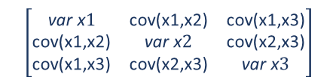

Step 2: Calculate Covariance Matrix
Measure how variables change together. For example:
- Cov(Age, Height) = Σ[(Ageᵢ − mean) × (Heightᵢ − mean)] / (n−1)
- Diagonal (Age, Age): Variance of Age.
$$\left[\begin{matrix}\text{var} \text{x}1 & \text{cov}\text{(}\text{x}\text{1,}\text{x}\text{2)} & \text{cov}\text{(}\text{x}\text{1,}\text{x}\text{3}\text{)} \\ \text{cov}\text{(}\text{x}\text{1,}\text{x}\text{2)} & \text{var} \text{x}2 & \text{cov}\text{(}\text{x}\text{2}\text{,}\text{x}\text{3}\text{)} \\ \text{cov}\text{(}\text{x}\text{1,}\text{x}\text{3}\text{)} & \text{cov}\text{(}\text{x}\text{2}\text{,}\text{x}\text{3}\text{)} & \text{var} \text{x}3\end{matrix}\right]$$
Cov =
Var(age) =
$$\frac{−{\left(0.5\right)}^{2}+{1.5}^{2}+{\left(−1.5\right)}^{2}+{\left(0.5\right)}^{2}}{3}=1.67$$
Similarly: Var(Height) = 41.6 , Var(Weight) = 125.0
Cov(age, height) =
$$\frac{(−0.5∗−2.5)+1.5∗7.5+\left(−1.5∗−7.5\right)+0.5∗2.5}{3}=8.33$$
Similarly: Cov(height, weight) = 66.67 , Cov(age, weight) = 13.33
Covariance Matrix (C):
Student | Age | Height | Weight
Age | 1.67 | 8.33 | 13.33
Height | 8.33 | 41.6 | 66.67
Weight | 13.33 | 66.67 | 125.0
(High positive values (e.g., Height-Weight = 87.5) mean they increase together.)

Slide 12
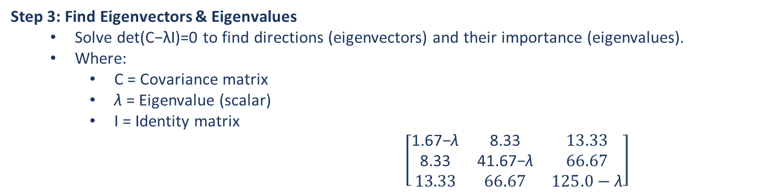
Step 3: Find Eigenvectors & Eigenvalues
Solve det(C−λI)=0 to find directions (eigenvectors) and their importance (eigenvalues).
Where:
C = Covariance matrix
λ = Eigenvalue (scalar)
I = Identity matrix
$\left[\begin{matrix}\text{1.67−}\text{λ} & \text{8.33} & 13.33 \\ \text{8.33} & \text{41.67−}\text{λ} & 66.67 \\ 13.33 & 66.67 & 125.0−\text{λ}\end{matrix}\right]$

Slide 13
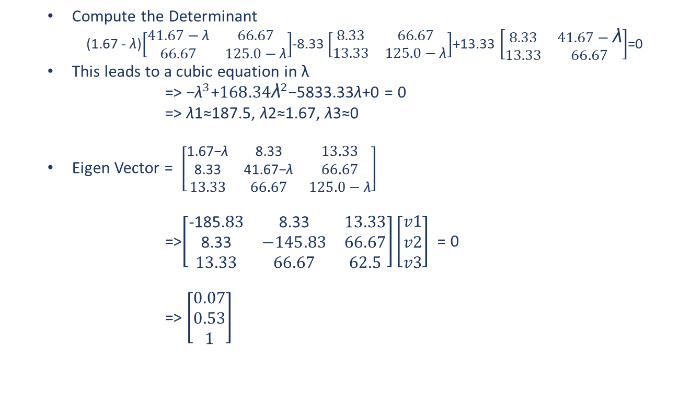
Compute the Determinant
(1.67 - $\text{λ}$)$\left[\begin{matrix}41.67−\text{λ} & 66.67 \\ 66.67 & 125.0−\text{λ}\end{matrix}\right]$-8.33 $\left[\begin{matrix}8.33 & 66.67 \\ 13.33 & 125.0−\text{λ}\end{matrix}\right]$+13.33 $\left[\begin{matrix}8.33 & 41.67−\text{λ} \\ 13.33 & 66.67\end{matrix}\right]$=0
This leads to a cubic equation in λ
=> −${\text{λ}}^{3}$+${168.34\text{λ}}^{2}$−5833.33λ+0 = 0
=> λ1​≈187.5, λ2​≈1.67, λ3​≈0
Eigen Vector = $\left[\begin{matrix}\text{1.67−}\text{λ} & \text{8.33} & 13.33 \\ \text{8.33} & \text{41.67−}\text{λ} & 66.67 \\ 13.33 & 66.67 & 125.0−\text{λ}\end{matrix}\right]$
=>$\left[\begin{matrix}\text{-185.}83 & \text{8.33} & 13.33 \\ \text{8.33} & −145.83 & 66.67 \\ 13.33 & 66.67 & 62.5\end{matrix}\right]\left[\begin{matrix}v1 \\ v2 \\ v3\end{matrix}\right]$ = 0
=> $\left[\begin{matrix}0.07 \\ 0.53 \\ 1\end{matrix}\right]$

Slide 14
Results:
Eigenvector 1 (PC1): [0.07, 0.53, 1]
Eigenvalue (λ₁): 187.5 (most variance!)
Captures ~99% of total variance (dominant pattern: Height-Weight correlation).
Eigenvector 2 (PC2): [-0.7, -0.56, 0.44]
Eigenvalue (λ₂): 1.67 (less variance)
Interpretation:
PC1 is a mix of Height + Weight (dominant pattern).
PC2 contrasts Age vs. Height/Weight.

Slide 15
Step 4: Choose Principal Components
Pick top eigenvectors (usually PC1 + PC2 for 2D visualization).
Selected PCs:
PC1: [0.07, 0.53, 1]
PC2: [-0.7, -0.56, 0.44]
Step 5: Transform Data to New Axes
Multiply centered data by eigenvectors to get new coordinates.
Transformed Data (2D):
Student | PC1 | PC2
1 | -2.6 | 1.1
2 | 15.8 | -0.4
3 | -15.6 | 0.8
4 | 2.4 | -1.5

Slide 16
03
Strengths and Limitations

Slide 17
Key Strengths
PCA is particularly advantageous due to its ability to effectively reduce dimensionality, which can improve the performance of machine learning algorithms by decreasing computation time and minimizing overfitting.
By removing noise and redundancy, PCA helps in enhancing the interpretability of the data.
It provides a clear visualization of the variance contained in the dataset, making it easier to identify patterns and relationships.
No Label Required: PCA is an unsupervised learning technique, meaning it doesn't require labeled data to extract meaningful features. This is useful when you're dealing with unlabeled data or when labels are difficult or expensive to obtain.

Slide 18
Notable Limitations
It assumes linear relationships among variables, which may not hold true for all datasets.
PCA does not inherently maintain interpretability, as the principal components are linear combinations of the original variables, making it difficult to attribute meaning to them.
Additionally, PCA is sensitive to scaling; thus, features with larger scales can disproportionately affect the result.

Slide 19
Comparison with Other Algorithms
When compared to other dimensionality reduction techniques, such as t-SNE or UMAP, PCA is generally faster and simpler; however, it may not capture complex structures as effectively as non-linear methods.
While t-SNE excels at capturing non-linear relationships, it can be computationally expensive and less interpretable. PCA, on the other hand, provides a balance between speed and interpretability, making it a go-to choice for initial data exploration.

Slide 20
04
Applications

Slide 21
Gene Expression Data
Gene expression datasets often contain thousands of genes, and PCA can be used to reduce the dimensionality of the data to a few principal components.
Ref: https://tavareshugo.github.io/data-carpentry-rnaseq/03_rnaseq_pca.html
Financial Fraud Detection
PCA reduces high-dimensional transaction data (location, amount, time) to detect anomalies (fraudulent patterns) via reconstruction error.
Ref: https://www.iosrjen.org/Papers/vol10_issue1/Series-1/C01001011014.pdf
Social Media Trend Detection
Analyzes live text/engagement metrics to identify trending topics by isolating dominant features in user behavior.
Ref: https://www.numberanalytics.com/blog/pca-entertainment-data-trends
Personalized Medicine
PCA helps identify subgroups of patients with distinct molecular or clinical characteristics, which is vital for personalized medicine.

Slide 22
05
Ongoing Research

Slide 23
Nonlinear Extensions
Traditional PCA is linear, but Kernel PCA maps data to a higher-dimensional space using kernels (e.g., RBF) to capture nonlinear patterns. Neural networks are also used to learn nonlinear PCA-like representations.
Ref: https://www.sciencedirect.com/science/article/pii/S089360802300669X
2. Incremental PCA
Updates PCA incrementally for streaming data (e.g., sensors, real-time systems) without recalculating from scratch, saving computational resources.
Ref: https://www.sciencedirect.com/science/article/pii/S089360802300669X
3. Deep Learning Integration
Combines PCA with autoencoders (e.g., using PCA for pre-training) or neural networks to boost feature extraction efficiency in hybrid models.
Ref: https://link.springer.com/article/10.1007/s11831-025-10260-5

Slide 24
Conclusions
Principal Component Analysis serves as a fundamental technique in data analysis and machine learning for feature extraction and dimensionality reduction.
Its strengths lie in its ability to simplify complex datasets while retaining essential variance.
While it has limitations, particularly with non-linear data and interpretability challenges, it remains a valuable method, especially during preliminary analysis and when paired with other algorithms to enhance its effectiveness.

Slide 25
Thank you!
Do you have any questions?
~ Bharath Kumar
~ Balaji Gollapalli Venkataswamy Reddy
~ Karthik Maganahalli Prakash

